Slide 1
أكـــــاديميــــة طــــويـــق
Deep Learning

Slide 2
Understanding Sequential Data
By: Dr. Afshan Hashmi

Slide 3
Course Objectives:
Analyze the nature and structure of sequential data such as time series, speech, and textual data, and understand their unique processing requirements.
Differentiate between feedforward and recurrent neural networks in terms of architecture, data handling capabilities, and use cases.
Apply foundational concepts of sequence modeling to real-world problems involving temporal, auditory, or language data.
Explore limitations of traditional neural networks in handling sequential dependencies and motivate the need for recurrent architectures.

Slide 4
Sequential Data
Sequential data is a type of data where the order of the data points matters. The value of one data point is often related to the values of the data points that came before it (and sometimes after).
Sequential data is data where the order of the elements is important because each element is dependent on the ones that precede it (and sometimes follow).
Key characteristics:
Order matters: The sequence of the data points carries information.
Dependencies: Data points are often related to each other within the sequence.
Examples: common examples include:
Time Series: Stock prices, sensor readings, weather data (ordered by time).
Text: Sentences, paragraphs, documents (ordered by words).
Audio: Speech, music (ordered by time).
Video: Frames (ordered by time).
Genomic Sequences: DNA, RNA (ordered by the sequence of bases).
User Activity: Website clicks, purchase history (ordered by time).
Because of these dependencies, analyzing sequential data often requires specialized techniques that can understand and model these relationships, such as Recurrent Neural Networks (RNNs) and Transformer networks.

Slide 5
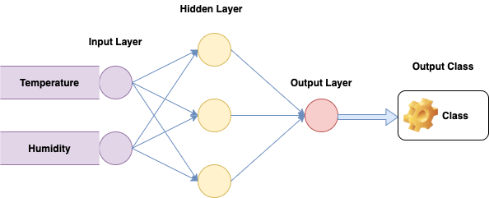
Struggle with sequential data
Statelessness: Traditional neural networks process each input independently. They don't have any memory of past inputs or the relationships between them. In your weather example, the network analyzes each day's temperature and humidity in isolation, without considering the weather from previous days.
Assumption of Independence: Feedforward networks are designed with the assumption that data points are independent of each other. This is fundamentally incorrect for sequential data where the order and dependencies between elements are crucial.

Slide 6
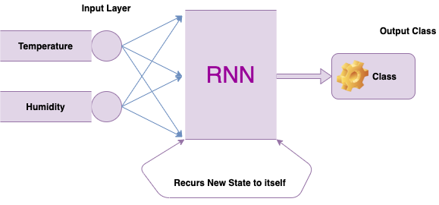
Struggle with sequential data
3. Ignoring Temporal Dependencies: Sequential data often has strong temporal dependencies. The weather on one day significantly influences the weather on subsequent days, stock prices are affected by previous trends, and the meaning of a word in a sentence depends on the words around it. Traditional neural networks cannot inherently capture these dependencies.

Slide 7
Struggle with sequential data
4. Fixed Input Size: Traditional neural networks typically require a fixed-size input vector. Sequential data, however, can have varying lengths (e.g., sentences of different lengths, time series with different durations). Handling variable-length sequences is challenging for these networks without significant preprocessing (like padding or truncating), which can lose information.
In essence, traditional neural networks lack a mechanism to maintain and utilize information about the order and dependencies within sequential data. They treat each data point as a separate, unrelated instance, which limits their ability to understand the underlying patterns and make accurate predictions in sequential tasks. This is precisely the problem that Recurrent Neural Networks (RNNs) and other sequence models are designed to address by incorporating memory and the ability to process sequences step by step

Slide 8
What is a Time Series?
A time series is a sequence of data points collected or recorded at successive points in time usually at uniform intervals.
Key Characteristics:
Ordered: Data is indexed in time order.
Temporal dependency: Past values influence future values.
Regular intervals: Often recorded daily, hourly, per second, etc.
Examples:
Sensor Data
Data collected from sensors in real time.
E.g., temperature readings from a weather station every hour.
Format:
Time | Temperature
-----------|------------
10:00 AM | 22.5°C
11:00 AM | 23.1°C
12:00 PM | 24.0°C

Slide 9
What is a Time Series?
Stock Prices
Financial data points like opening price, closing price, volume, etc., recorded every minute/hour/day.
Date | Close Price
-----------|-------------
2024-01-01 | $150.30
2024-01-02 | $151.20
2024-01-03 | $148.70
Used for Prediction: Forecasting future values

Slide 10
Speech Data: Waveforms and Spectrograms
What Is Speech Data?
Speech is an audio signal a time series representing the air pressure variations over time. When captured digitally, it's stored as a waveform, typically in formats like .wav, .mp3, etc.
Waveform-A waveform is a raw audio signal: a one-dimensional sequence of amplitude values sampled over time.
Example: x(t) = [0.0, 0.2, -0.1, ...] (values sampled at 16,000 Hz or 44,100 Hz).
Use case: Used in raw audio processing like speech enhancement or recognition.
Spectrogram-A spectrogram is a visual representation of the spectrum of frequencies over time.
It’s derived from a waveform using a Short-Time Fourier Transform (STFT).
It captures:
Time (x-axis)
Frequency (y-axis)
Amplitude (energy) (color intensity)
Use case: Deep learning models (like CNNs) often use spectrograms to classify audio signals, detect emotions, or recognize spoken words.

Slide 11
Text Data: Character/Word Sequences
What Is Text Data?
Text is a sequence of tokens — these tokens can be characters, words, or subword units (like in BERT or GPT models).
Character Sequences
Each character is treated as a token.
Example: "hello" → ['h', 'e', 'l', 'l', 'o']
Useful for:
Language modeling (predict the next character)
Spell correction
Text generation
Word Sequences
Each word is a token.
Example: "I love AI" → ['I', 'love', 'AI']
Used in:
Sentiment analysis
Machine translation
Text classification

Slide 12
Text Data: Character/Word Sequences
Encoding Text
Before feeding text to a model, we must convert tokens into numbers:
One-hot encoding
Integer encoding
Embeddings (e.g., Word2Vec, GloVe, BERT embeddings)
RNN or Transformer for Text
Text sequences are input to RNNs, LSTMs, or Transformers to capture dependencies.
These models learn how previous words (or characters) influence future ones.
Data Type | Representation | Visualization | Use Cases
Speech (raw) | Waveform | Line plot | Speech-to-text, speaker ID
Speech (proc) | Spectrogram | Heatmap | Emotion detection, music genre
Text | Word/char sequence | Token indices | Translation, sentiment analysis

Slide 13
1. Prediction (Forecasting Future Values)
Goal: Use past time-ordered data to predict what happens next.
Examples:
Weather Forecasting Using temperature, humidity, and pressure over time to predict tomorrow’s weather.
Stock Price Forecasting Estimating future prices based on past stock values.
Energy Demand Forecasting Predicting electricity demand to balance supply in power grids.
Why it's important:
Helps in decision-making (e.g., when to buy/sell stocks).
Optimizes resource allocation (e.g., how much energy to produce).
Prevents waste and loss (e.g., managing perishable inventory based on demand).
Tools/Models:
ARIMA, SARIMA
LSTM (Long Short-Term Memory)
Prophet (by Facebook)

Slide 14
2. Anomaly Detection
Goal: Identify data points that deviate significantly from the norm.
Examples:
Faulty Sensor Detection A temperature sensor that suddenly reports 1000°C—clearly faulty.
Network Intrusion Detection Unusual spikes in internet traffic could indicate cyberattacks.
Healthcare Monitoring Detecting abnormal heart rates or ECG patterns in real-time.
Why it's important:
Prevents system failures and safety issues.
Enables real-time alerts and preventive maintenance.
Crucial in fraud detection in banking and finance.
Tools/Models:
Statistical methods (Z-score, moving average)
Autoencoders
Isolation Forest, One-Class SVM

Slide 15
3. Pattern Recognition
Goal: Identify regularities, such as trends or cycles, in the data.
Types of patterns:
Trend: Long-term increase or decrease (e.g., gradual rise in global temperatures)
Seasonality: Repeating patterns over fixed time intervals (e.g., ice cream sales peak in summer)
Cyclic behavior: Irregular up and down movements (e.g., economic cycles, business revenue)
Why it's important:
Improves strategic planning (e.g., when to launch marketing campaigns).
Enables capacity planning (e.g., scaling up infrastructure during peak usage).
Reveals underlying causes driving business metrics.
Tools/Models:
Decomposition techniques
Fourier Transform
Seasonal ARIMA (SARIMA)

Slide 16
Summary
Application | Description | Example Use Case
Prediction | Forecasting future values | Sales forecast for next quarter
Anomaly Detection | Spotting abnormal/unexpected behavior | Identifying equipment failures
Pattern Recognition | Recognizing trends and seasonality | Tracking COVID-19 spread over time

Slide 17
Feedforward vs. Recurrent Networks
1.1 Feedforward Neural Networks (FFNs)
In an FFN, data flows only in one direction: from input to output.
Each input is processed independently — no memory of past inputs.
Typically used for classification, regression, etc.
Limitation:
FFNs expect fixed-size inputs, e.g., an image of 28×28 pixels or a vector of 100 features.
Cannot naturally model sequences like text or time series.
1.2 Recurrent Neural Networks (RNNs)
RNNs are designed to handle sequential data.
They maintain a hidden state that evolves over time, capturing past context.
Key Features:
Parameter Sharing:
The same weights are used at every time step — unlike FFNs.
Fewer parameters, generalizes better.
Hidden State as Memory:
Maintains a memory of previous inputs via the hidden state vector hₜ.

Slide 18
RNN Vs FFN
Feedforward Neural Networks:
Structure: Consist of layers where data flows in one direction (input to output).
No Memory: Lack feedback loops or internal memory to retain past information.
Learning: Effective at learning static patterns and mapping fixed inputs to outputs.
Limitations with Sequential Data: Cannot inherently handle data where the order and temporal dependencies are important (e.g., text, speech, video).
Recurrent Neural Networks (RNNs):
Structure: Designed to handle sequential or temporal data.
Memory Mechanism: Possess recurrent connections (loops) that allow them to store information from previous inputs and outputs.
Learning: Capable of learning dynamic patterns and capturing long-term dependencies and context within sequences.
Suitability for Sequential Data: Well-suited for tasks involving data where the order and relationships between elements are crucial.

Slide 19
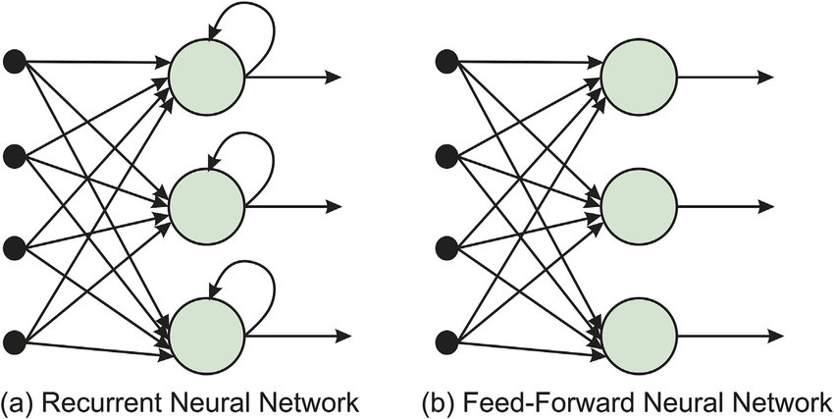
RNN Vs FFN

Slide 20
RNN Vs FFN
Comparison Attribute | Feed-forward Neural Networks | Recurrent Neural Networks
Signal flow direction | Forward only | Bidirectional
Delay introduced | No | Yes
Complexity | Low | High
Neuron independence in the same layer | Yes | No
Speed | High | slow
Commonly used for | Pattern recognition, speech recognition, and character recognition | Language translation, speech-to-text conversion, and robotic control

Slide 21


Hands On Exercise
Click Here For The Implementation on Google Colab
https://drive.google.com/file/d/18eIHAM_F9bx6VhXNZynK_RY_OeygZmm-/view?usp=sharing

Slide 22
Books and References
"Deep Learning" (Ian Goodfellow et al.)
"Neural Networks and Deep Learning" (Michael Nielsen)
Deep Learning for Computer Vision (Rajalingappaa Shanmugamani)
https://www.geeksforgeeks.org/difference-between-feed-forward-neural-networks-and-recurrent-neural-networks/
Datasets: COCO, Pascal VOC, Cityscapes

Slide 23

















الشراكات العالمية

Slide 24
شــــــكــــرًا لكــــــم
THANK YOU

